Slide 1
Pariksha (Online Desktop Examination System) oom mini project
Group Number - 59
Harsh Kumar (IIT2021256)
Sanjay Vishnoi (IIT2021091)
Ramesh Kumar (IIT2021093)

Slide 2
abstract
In this project, we designed and developed software for a 10-question online exam system. Users can mark questions for review while navigating to results and click the Next button to advance to the next question.
The online exam system meets the institution's requirements for conducting exams online. Here we use a Java array to store the question, options and answers. No database technology is used.
We enriched this project by using a Swing frame as a container and buttons and checkboxes as components. The software gives students the option to select questions with increasing levels of complexity if they want to achieve higher points leading to higher grades. So in this software he can provide 3 levels of problems (good, hard and complex) depending on the level of complexity. Scores are assigned according to student rules (example) best grades are achieved only with 80% or more correct answers for good questions and 25% and 10% correct answers for difficult and complex questions respectively increase. However, students are able to correctly answer larger questions from difficult or complex problems, reducing the need to answer questions correctly from good ones. So I used a timer for a fixed amount of time to create a good rule for this decision.

Slide 3
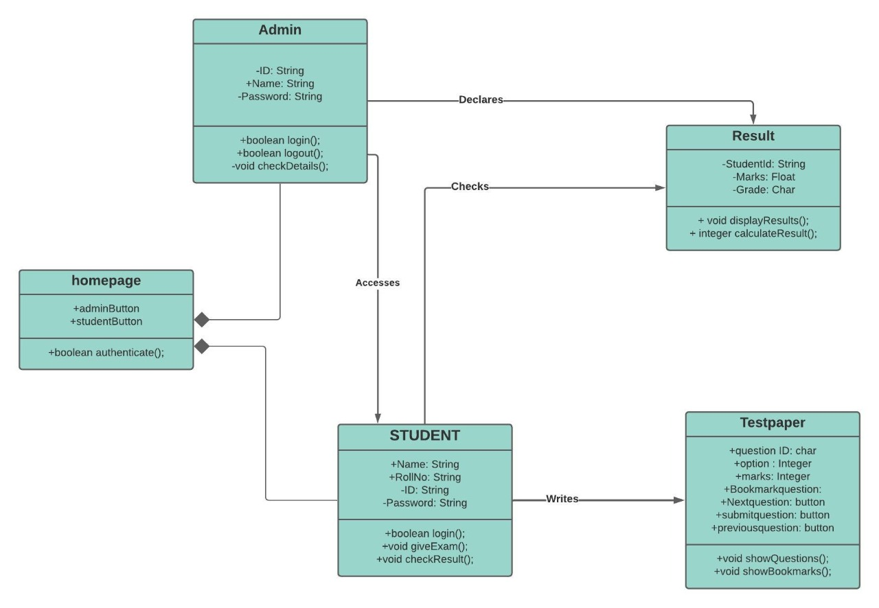
Class Diagram

Slide 4
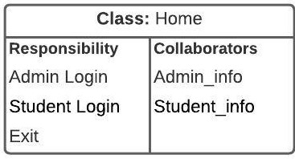
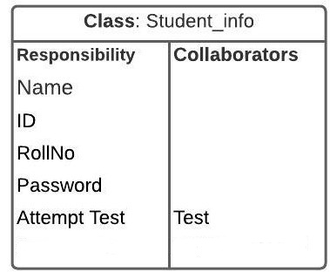
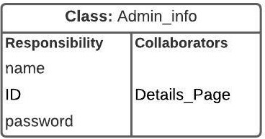
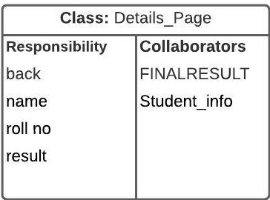
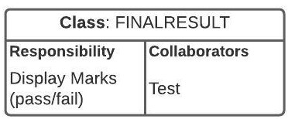
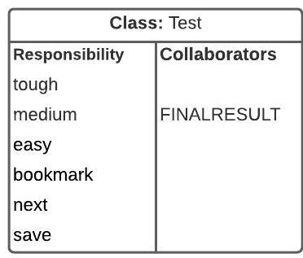
CRC Diagram

Slide 5
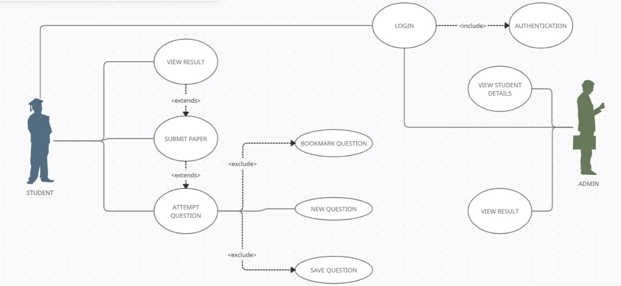
Use Case Diagram

Slide 6

Home page

Slide 7

Admin Login

Slide 8
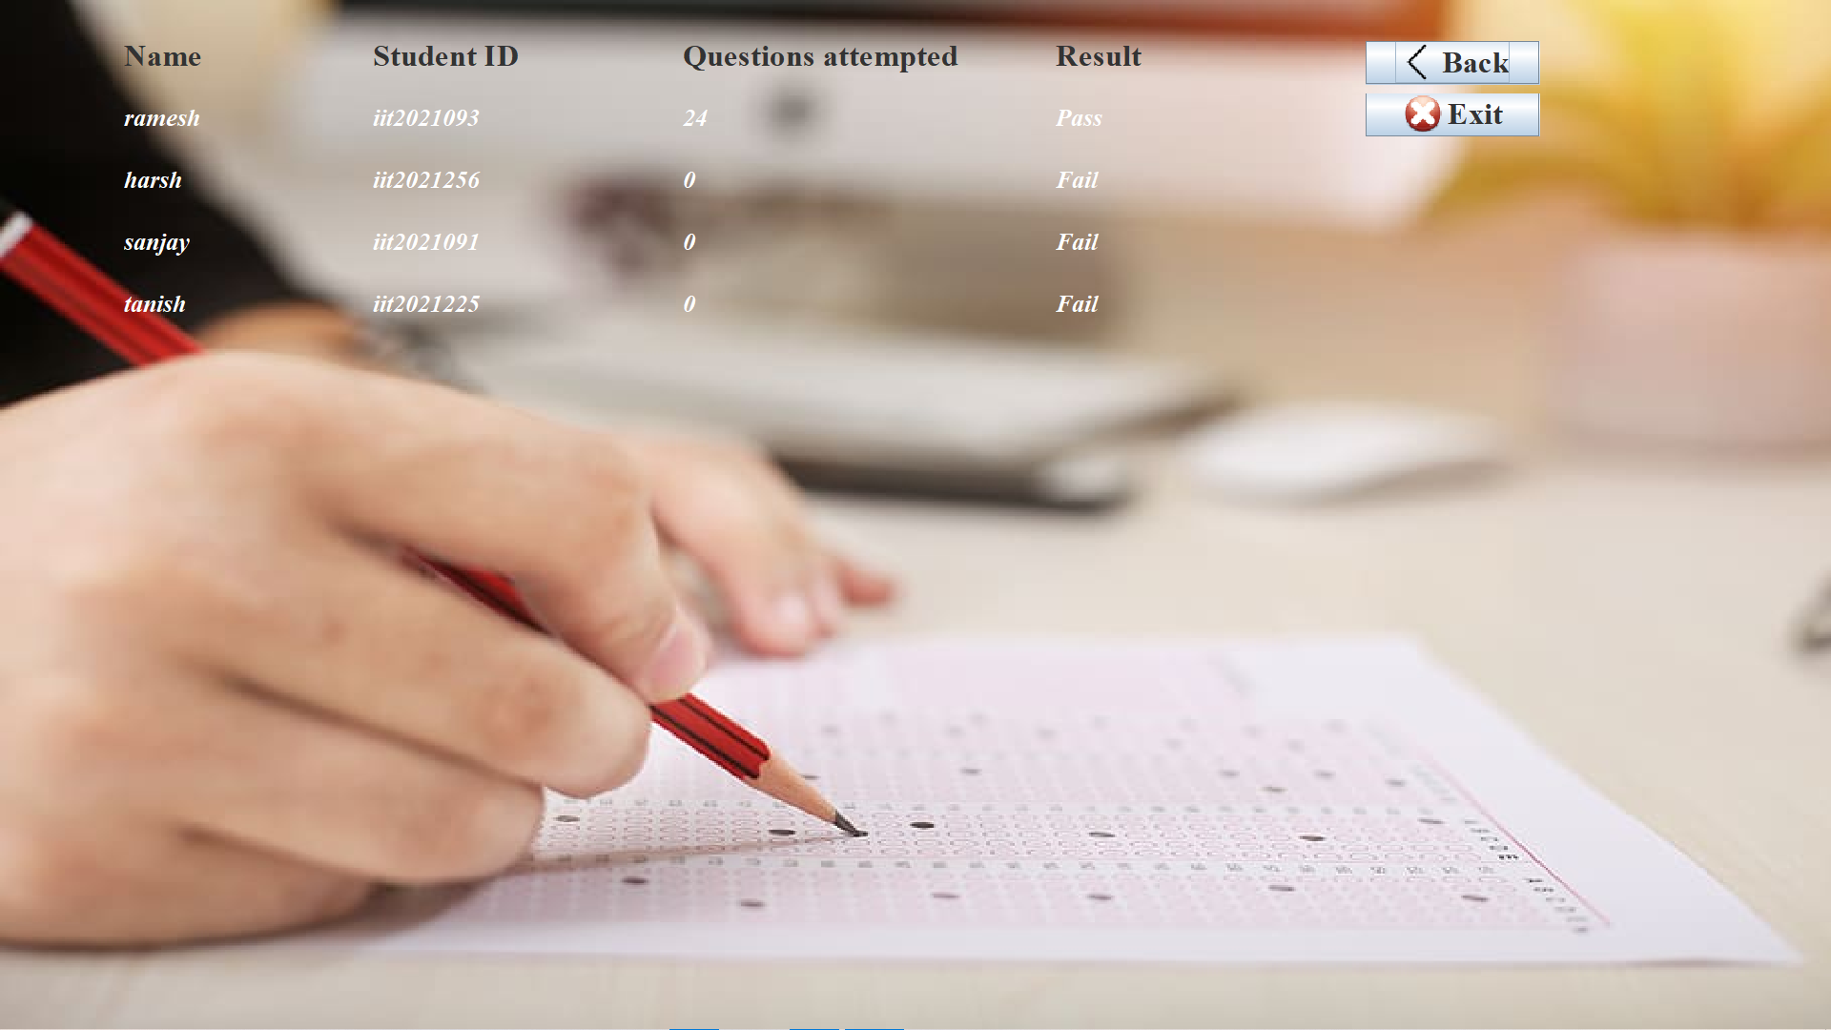
Detail page

Slide 9

Student login

Slide 10
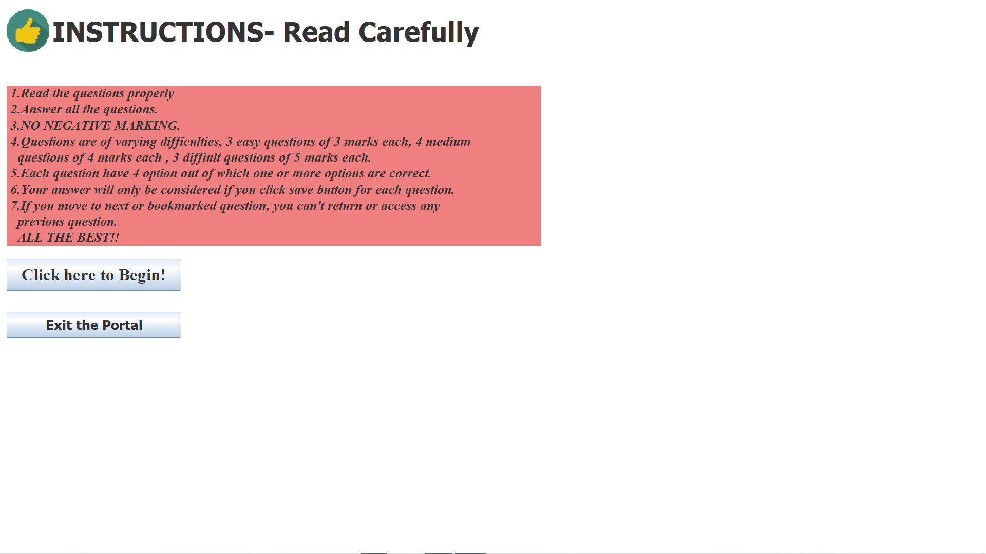
Instruction page

Slide 11
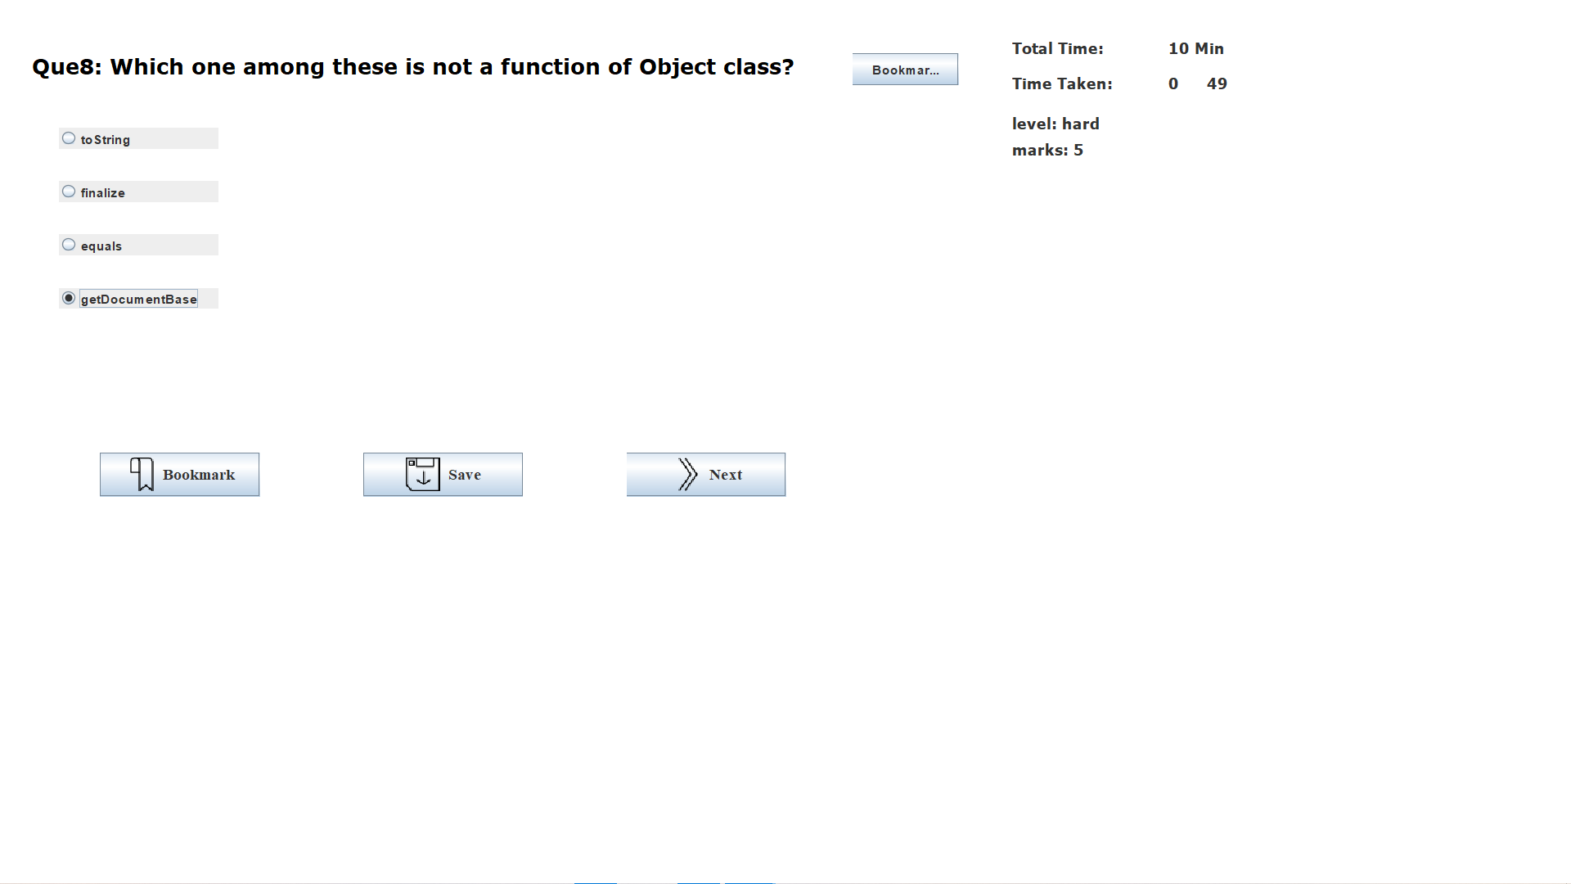
Test

Slide 12
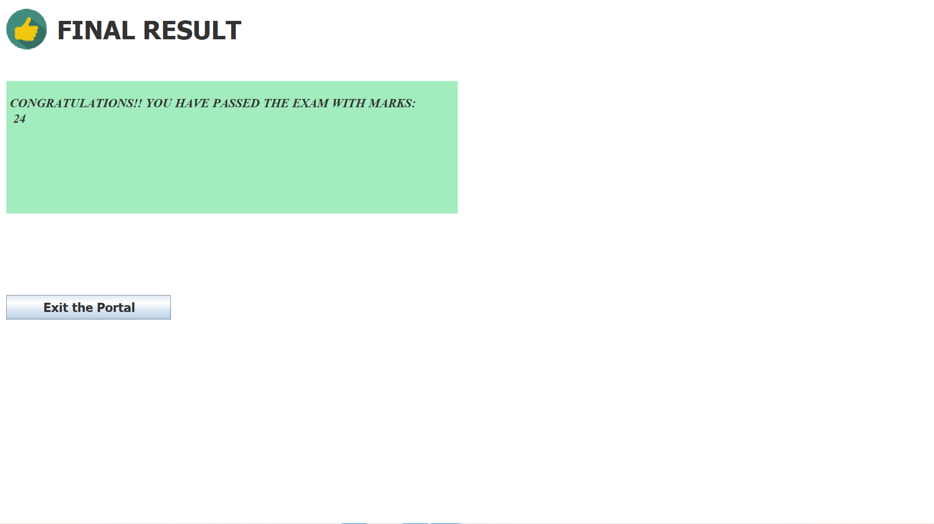
Student result

Slide 13
Classes
Home
Student Info
Admin Info
Details Page
Test
Final Result

Slide 14
Home
The home class contain two admin and student buttons which specifically take to respective login page. An exit button is also present in this class
Admin Info.
This class contains information about admin i.e. admin name, admin id and password.
Student Info.
This class contains information about student which include name, enrollment no., password and attempt test.

Slide 15
Test
This class shows the question and options and allow user to choose one of the option. In the background, it is calculating the score i.e. marks of the student. It also contain bookmark, next and save buttons
Detail page
Only admin have access to this class, it contains the information of all the students who given the test with there marks and remarks.
Final result
Student have access to this class after giving this test. They can see their result and remarks.

Slide 16
Future Expectations
In this mini project we have used java swing for GUI design. We have not used database technology so in future version of this application we will use database to store information of student, admins and questions.
We will add a feature of discussion panel in our application where every user can interact
We will also add some more courses and will provide solution to all problems.
We will organize quizzes were best performer will be awarded prizes.
Here we will add some features where student can comment on questions and ask their doubts.

Slide 17




Thank you

